Slide 1

NO PHISHING ZONE
Milestone 3
ADAM MILLS
DYLAN REDDEN
CHRIS SCHMITT
DENNIS UGBEBOR

Slide 2
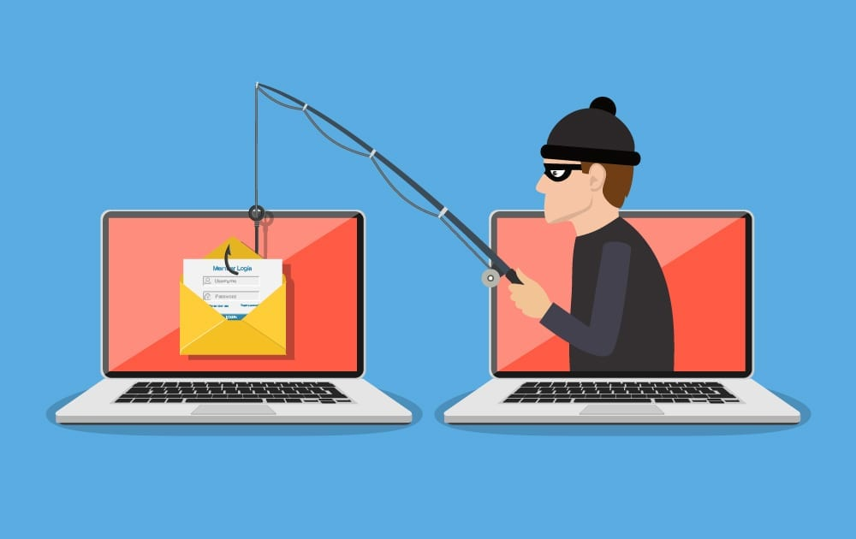
Reminder - What are we?
Goal: Safe-browsing enhancement tool for average user
Premise: Average user might not have
  Cybersecurity Awareness training/exposure
  Proficient understanding of the tool (webmail) they’re using
  Access to methods for improvement
Notes:
Goal: a tool that helps users see malicious links in their emails, that they otherwise may not see.
Target audience is the a casual internet user who may not know what danger signs to look for in an email, because they lack … *read premise points*

Slide 3
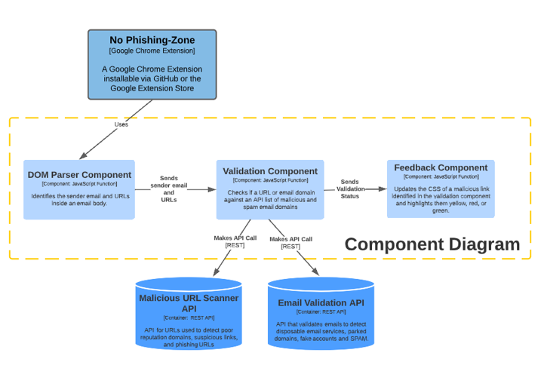
Prototype Structure
Notes:
Email page is loaded up by Chrome browser.
Program waits a short period of time to allow page to fully load (avoiding race instance).
DOM is parsed and URLs inside email body are read into the program.
Found URLs are then compared the IPQualityScore API
A validation status and risk rating is sent to the CSS of the email for the outcome of the comparison for the user to see.
Red for “dangerous”.
Yellow for “unknown”.
Green for “safe”.

Slide 4
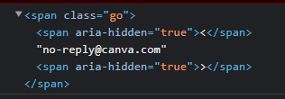

Development
Accomplishments
Difficulties
Functioning Chrome Extension
Extension ingests:
  Sender Email Address
  URLs in Body of Email
Functions:
  Manipulate CSS of web page
  Validate Senders email address
High levels of obfuscation
Navigating tree structures
Incompatibility between different browser-based web clients
API Limit
General lack of exposure to web development
Notes:
Top left is Google Mail
Top right is Outlook
Bottom is Yahoo
Discuss differences between the 3 mail clients and how nothing matches and can be obfuscated also highlight how this was the same case for the email body which made it extremly difficult to make this a cross email client extension

Slide 5
IPQualityScore API
Email API
URL API
valid - Does this email address appear valid? - Boolean
disposable - Is this email suspected of belonging to a temp or disposable mail service? - Boolean
overall_score -
  0 = invalid email address
  1 = dns valid, unreachable mail server
  2 = dns valid, temporary mail rejection error
  3 = dns valid, accepts all mail
  4 = dns valid, verified email exists
phishing - Is this URL associated with malicious phishing behavior?
malware - Is this URL associated with malware or viruses?
parking - Is the domain of this URL currently parked with a for sale notice? - Boolean
spamming - Is the domain of this URL associated with email SPAM or abusive email addresses? - Boolean
risk_score -
  Risk Scores < 80 - Safe
  Risk Scores >= 75 - suspicious - usually due to patterns associated with malicious links.
  Risk Scores >= 85 - high risk - strong confidence the URL is malicious.
  Risk Scores = 100 AND Phishing = "true" OR Malware = "true" - indicates confirmed malware or phishing activity in the past 24-48 hours.
Notes:
We found IPQualityScore for an API that allows us to validate emails and URLs to identify suspicious or potentially malicious URLs. IPQualityScore offers a variety of different risk analysis APIs designed to Proactively Prevent Fraud. It does require the user to register for an API key and can only hit 200 API calls a day and 1000 a month. A brief example of the API calls used can be seen on the slide (explain briefly)

Slide 6
Future Work
Expand on the richness offered by the API
Create a Reporting Feature to Report Malicious URLs
Expand to Cross Browser and Cross Mail Client Extension
Upgrade Application to Support Manifest V3
Identify another API or Create a Custom Allow/Deny List
Notes:
Future work could expand on what we did by implementing a more robust analysis of an email address or URL. IPQualityScore also offers a reporting feature where users can report malicious URLs or Emails.
We could add a reporting feature to the Extension Popup
Expand support Cross Browser Cross Mail Client
Currently our extension was created for Google Chrome Manifest version 2, would could expand support to Manifest version 3 and get the extension inside the Google Chrome Store
Since the API is only limited to 200 calls a day, an average user could quickly exceed the max calls in a matter of minutes. If we implement our own allow/deny list we could bypass the API however the API offered such rich features we chose to accept this limitation.

Slide 7

Live Demonstration

Slide 8

QUESTIONS? FEEDBACK?

